Slide 1

Accuracy & Precision
Testing the Precision of Niryo Ned 2 arm with MoveIt_commander

Slide 2
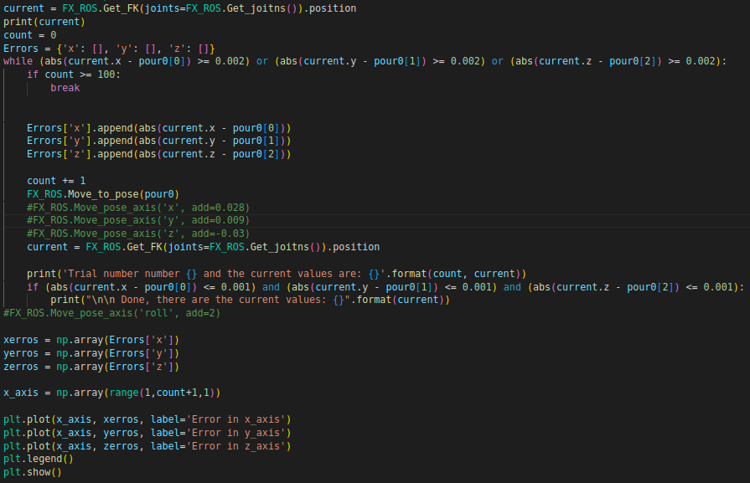
Python Package (moveit_commander)

Slide 3
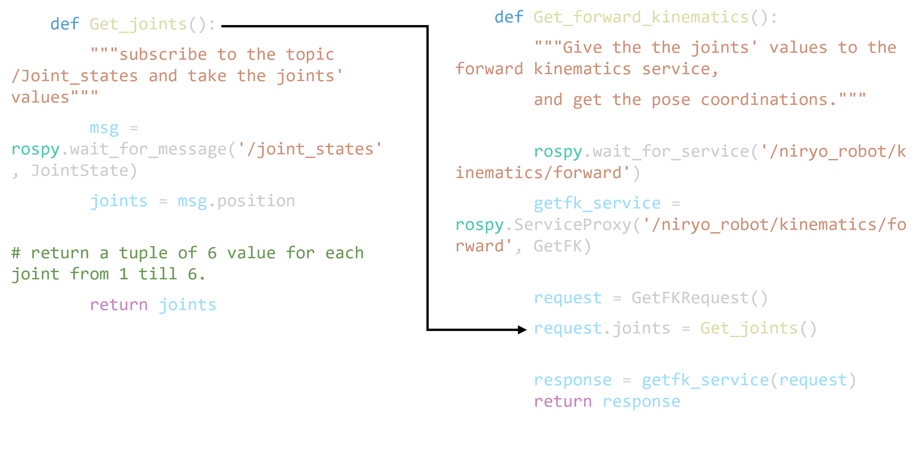
How we get the current Pose
Using forward kinematics!
Position:
x: 0.278
y: 0.101
z: 0.425
Rpy:
roll: 0.02575275
pitch: 0.70905463
yaw: 0.003150567
Sample Output

Slide 4
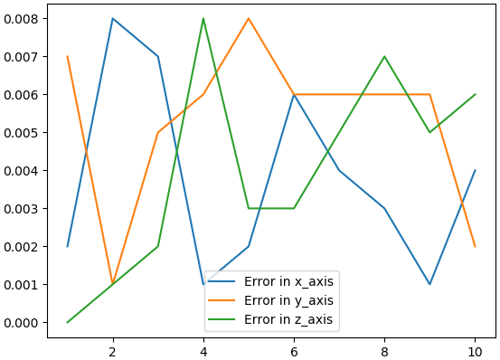
10 TIMES
Plotting the errors in x, y, z- axis’s to se the precision.
The X – axis of the graph represent the trial number.
Whereas Y – axis represent the error in meters (m).

Slide 5
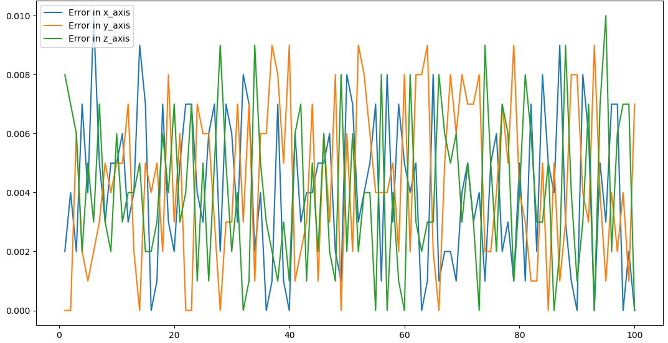
100 TIMES
Plotting the errors in x, y, z- axis’s to se the precision.
The X – axis of the graph represent the trial number.
Whereas Y – axis represent the error in meters (m).
The worst error is around 10 mm (which is huge)

Slide 6

Conclusion of this bad accuracy
With repeatable tasks, we could end up with a hug compound error.
Which could result in totally different endpoint after a certain # of repetitions.

Slide 7
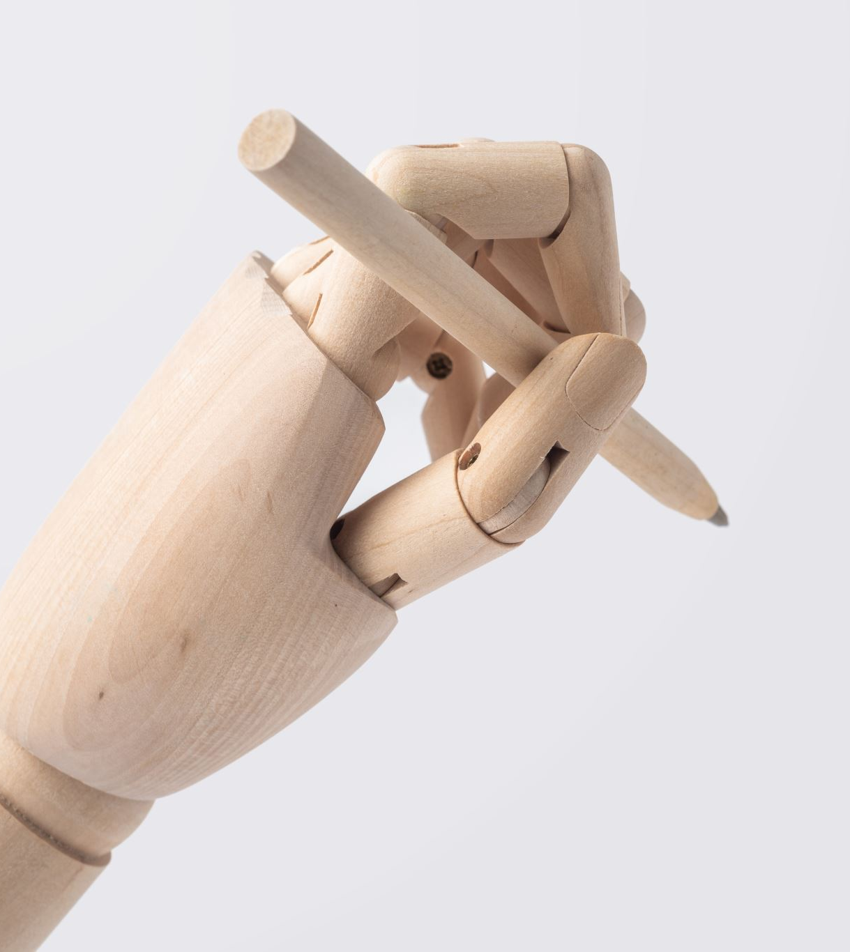
Corrections made to increase accuracy
Get the current Pose values from the RobotState topic directly
Use Forward kinematics service from MoveIt rather than the one provided from Niryo
Clear the Pose targets after each motion planning using Pose.

Slide 8
Getting current Pose directly from RobotState topic
def get_current_pose():
return Subscribe('/niryo_robot/robot_state', RobotState, ['position', 'rpy'])
Sample Output
Position:
x: 0.278629617856
y: 0.1013472393721
z: 0.425372867587
Rpy:
roll: 0.0257527549769
pitch: 0.7090546366178
yaw: 0.0031505670928
More precise Pose output!

Slide 9
Using Forward Kinematics from MoveIt service
def FK_Moveit(joints):
from moveit_msgs.srv import GetPositionFK
from moveit_msgs.msg import RobotState as RobotStateMoveIt
from std_msgs.msg import Header
rospy.wait_for_service('compute_fk', 2)
moveit_fk = rospy.ServiceProxy('compute_fk', GetPositionFK)
fk_link = ['base_link', 'tool_link']
header = Header(0, rospy.Time.now(), "world")
rs = RobotStateMoveIt()
rs.joint_state.name = ['joint_1', 'joint_2', 'joint_3', 'joint_4', 'joint_5', 'joint_6']
rs.joint_state.position = joints
reponse = moveit_fk(header, fk_link, rs)
return reponse.pose_stamped[1].pose

Slide 10

Clear Pose-targets after each motion planning
arm.set_pose_target(pose)
Plan = arm.go(wait=True)
arm.stop()
arm.clear_pose_targets()

Slide 11
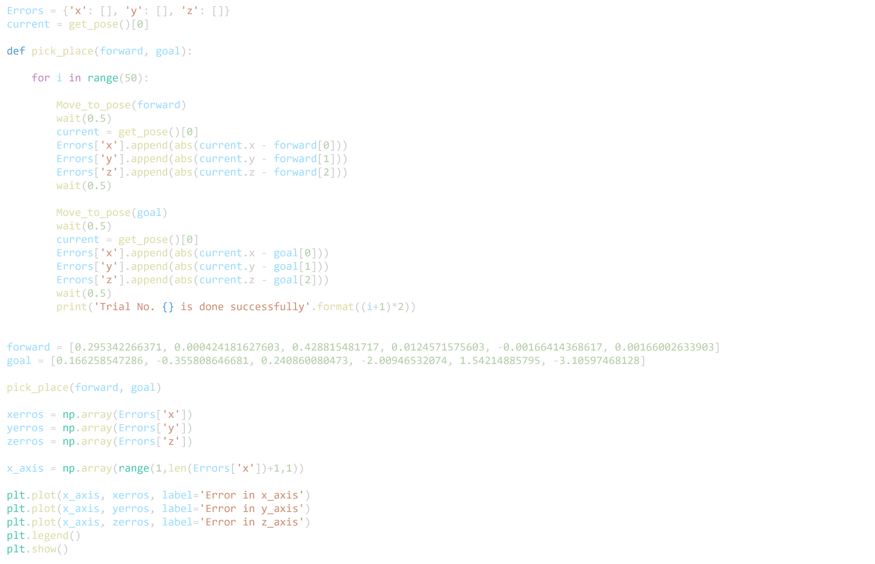
Applied code to test the precision

Slide 12
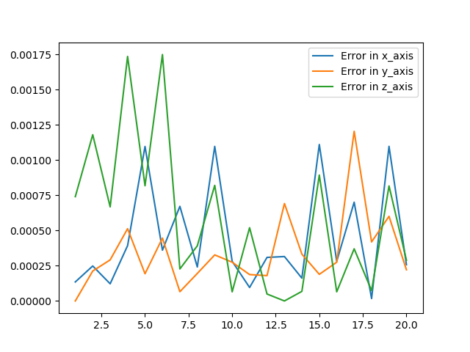
20 TIMES
Plotting the errors in x, y, z- axis’s to see the precision.
The X – axis of the graph represent the trial number.
Whereas Y – axis represent the error in meters (m).

Slide 13
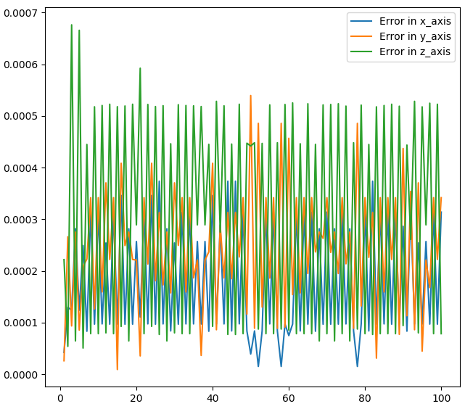
100 TIMES
Plotting the errors in x, y, z- axis’s to se the precision.
The X – axis of the graph represent the trial number.
Whereas Y – axis represent the error in meters (m).
The worst error is around 0.7 mm (happened ony twice in 100 times)
The mean error values is at around 0.3 mm!

Slide 14
Comparison

